Slide 1
Python and decision tree
https://scikit-learn.org/stable/modules/tree.html#classificationhttps://machine-learning-python.kspax.io/
Tom Michelle Machine Learning: http://www.cs.cmu.edu/~tom/mlbook-chapter-slides.html

Slide 2
Supervised and un-supervised machine learning
Supervised and unsupervised
Supervised machine learning: classification and prediction
Unsupervised machine learning: clustering
Decision tree technique: predicting the value of a target variable by learning simple decision rules (decision tree) inferred from the data features

Slide 3
Applications of Machine Learning
Discover the impact of strategies
Eighty-five students of National Open University
Using Web learning system
Learning Human Computer Interaction
Last 4 months
Perform Discussion activities
Teachers enforce a Q&A activity to promote discussion performance

Slide 4
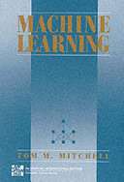

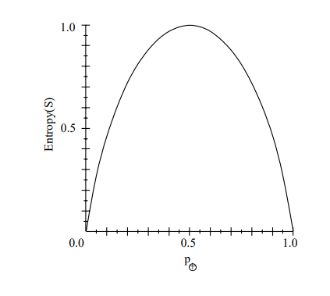
Algorithm (請參考Tom Michelle Machine Learning)
Entropy: the degree of impurity of a group S
http://www.cs.cmu.edu/~tom/mlbook-chapter-slides.html

Slide 5
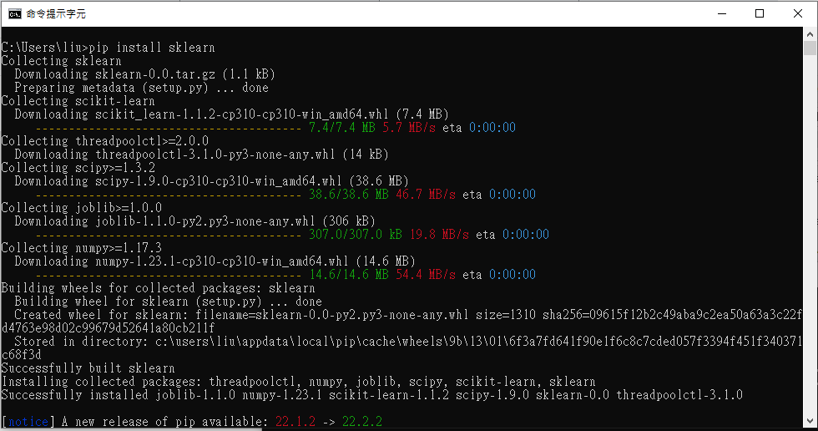
Run decision tree learning with sklearn
Install sklearn with pip by the comment “pip install sklearn”

Slide 6
Run decision tree learning with sklearn
sklearn
DecisionTreeClassifier is a class capable of performing multi-class classification on a dataset.
Input two arrays:
an array X of shape (n_samples, n_features) holding the training samples,
an array Y of integer values, shape (n_samples,), holding the class labels for the training samples
from sklearn import tree
X = [[0, 0], [1, 1]] //輸入兩個instance, 個別有兩個attribute
Y = [0, 1] //輸入兩個instance的類別
clf = tree.DecisionTreeClassifier() // 創一個decision tree classifier
clf = clf.fit(X, Y) //將training data 以classifier 做學習
print (clf.predict([[2., 2.], [0., 0.], [-2., -2.]])) //以學習好的decision tree 模型分類三個instance

Slide 7
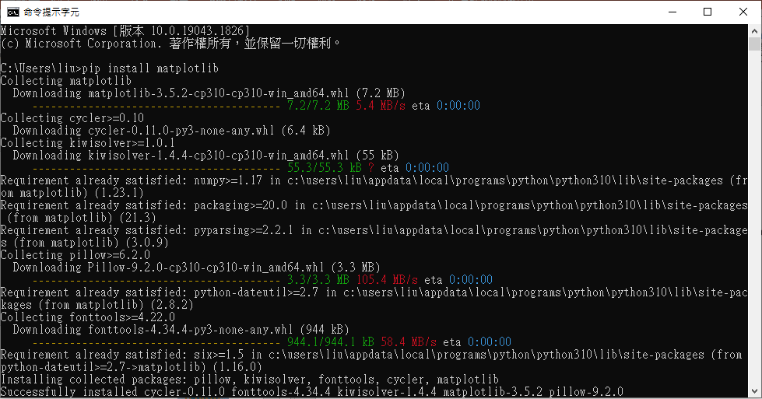
Draw out the decision tree
Install matplotlib by the comment “pip install matplotlib”

Slide 8
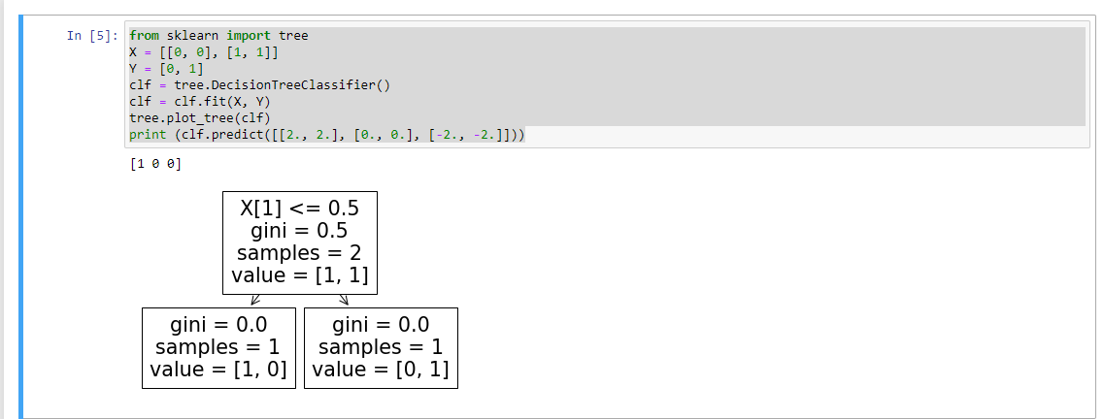
Draw out the decision tree
from sklearn import tree
X = [[0, 0], [1, 1]]
Y = [0, 1]
clf = tree.DecisionTreeClassifier()
clf = clf.fit(X, Y)
tree.plot_tree(clf) //畫出decision tree, 記得安裝matplotlib
print (clf.predict([[2., 2.], [0., 0.], [-2., -2.]]))

Slide 9
Classify new cases with the decision tree learned
from sklearn import tree
X = [[0, 0], [1, 1]]
Y = [0, 1]
clf = tree.DecisionTreeClassifier()
clf = clf.fit(X, Y)
tree.plot_tree(clf)
print (clf.predict([[2., 2.], [0., 0.], [-2., -2.]])) //the use tree to classify 3 new cases

